Slide 1
Subject: GCSE Art and Design BTEC Art and Design GCSE Photography
Head of Department: Miss Kerry

Slide 2
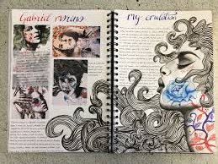
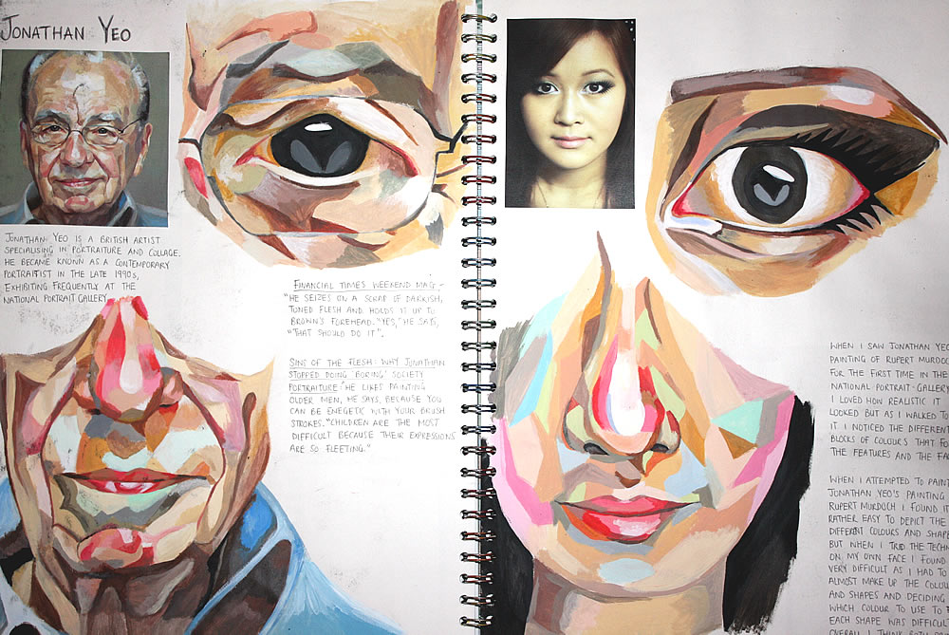
GCSE Art, Craft and Design course overview
GCSE Art and Design is suitable for students with an interest in drawing and painting who are willing to be creative. ... Students are encouraged to be experimental, to work from observation and imagination, and to develop their ideas from the beginning to the end.

Slide 3
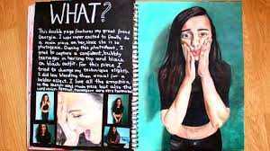
GCSE Art, Craft and Design course overview
Areas of study:
Fine Art
Textiles
Graphic Communication
3D Design
Photography
Students undertaking the Art, Craft and Design title are required to create work associated with areas of study chosen from at least two areas of study which will be achieved through your coursework projects.

Slide 4
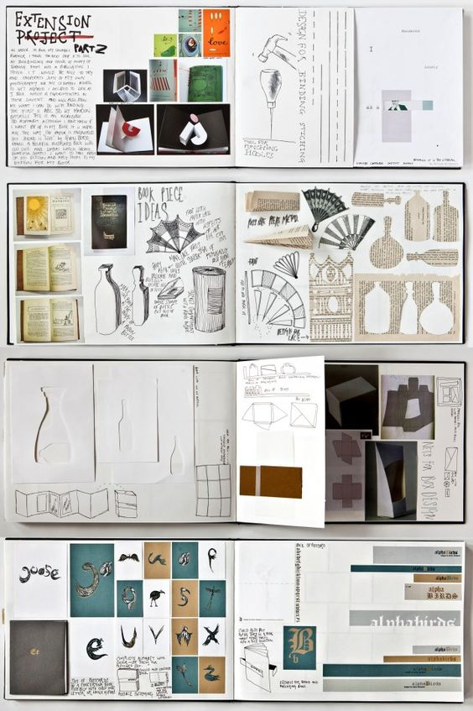
BTEC Art and Design course overview
The course is designed to provide students with:
An understanding of how organisations in the art and design industry operate.
The key skills required to work in the industry.
Key concepts and principles related to the world of art and design.

Slide 5
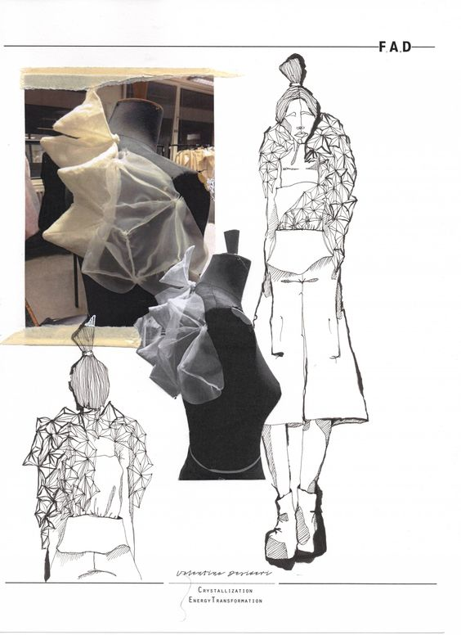
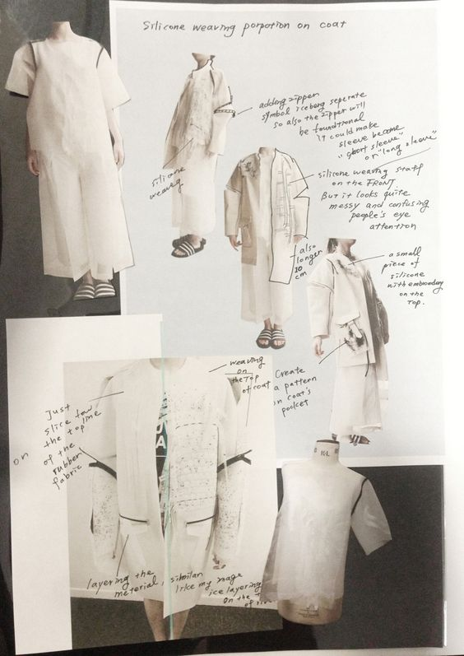
BTEC Art and Design course overview
The course is equivalent to a GCSE qualification where students will be given the opportunity to develop a range of skills and techniques, personal skills and attributes essential for successful performance in working life. Learners will be introduced to the following disciplines through a combinations of workshop lessons and termly units of work:
Design Crafts
Visual Arts
Visual Communication
Product Design

Slide 6
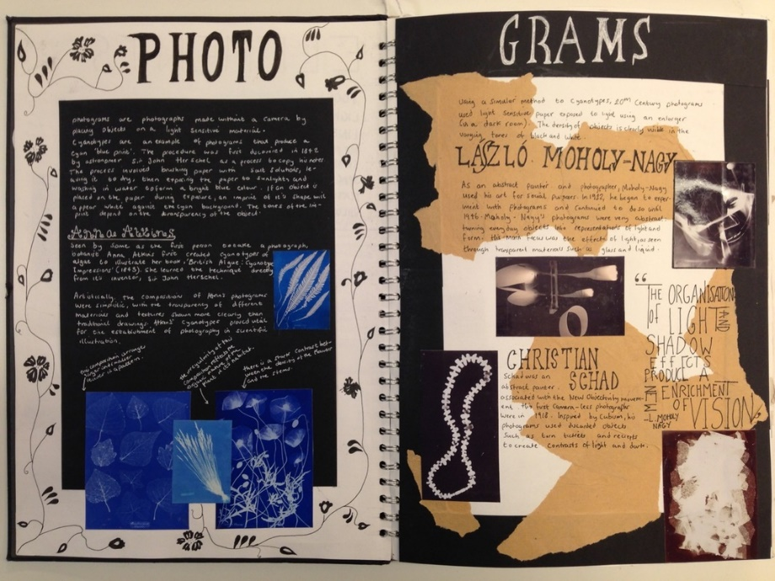
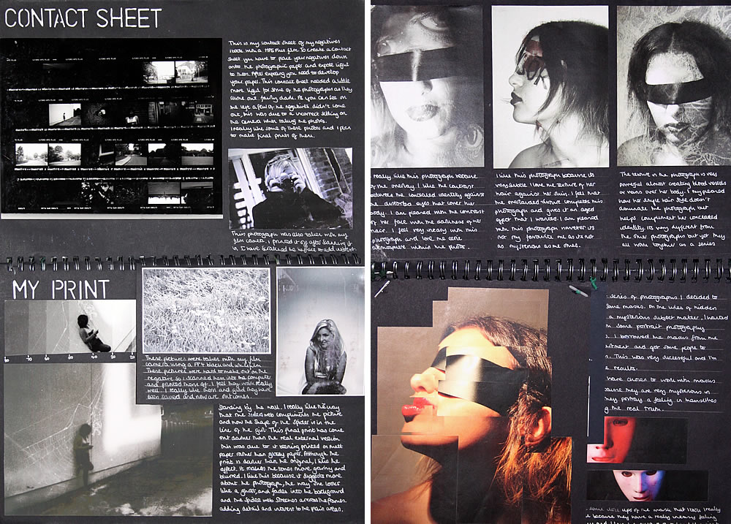
GCSE Photography course overview
Studying photography enhances your creative, social and cultural understanding, while developing your specialist technical knowledge around equipment, techniques and style.

Slide 7
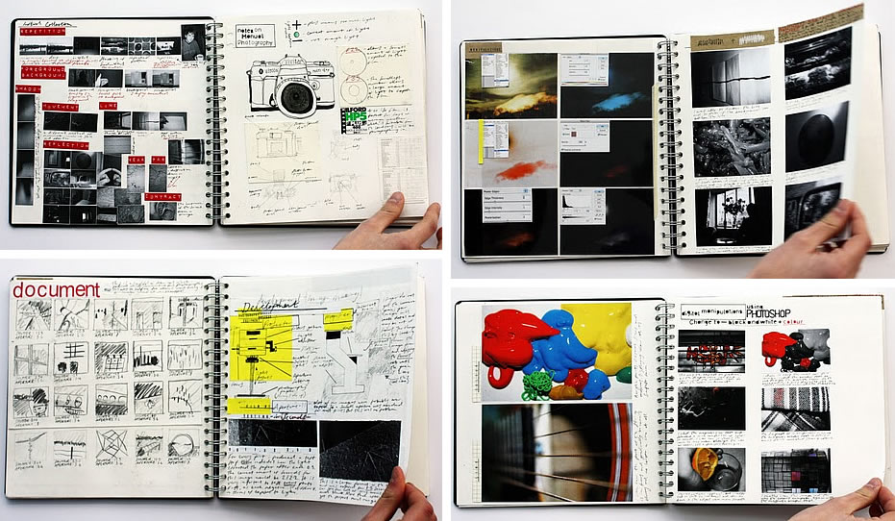
GCSE Photography course overview
Areas of study
Documentary Photography
Photo Journalism
Studio Photography
Location Photography
Experimental Photography
Installation Photography
Moving image: Film, Video and Animation

Slide 8
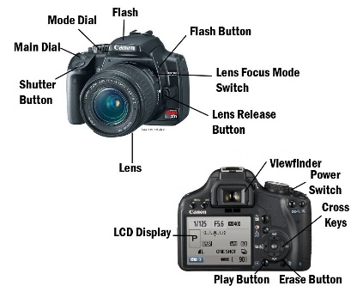
GCSE Photography course overview
In addition to any specialist requirements listed under the chosen areas of study, students should develop a practical knowledge and understanding of:
The use of formal elements to communicate a variety of approaches
The camera and its functions, including depth of field, shutter speed, focal points and viewpoints
The application of observational skills to record from sources and communicate ideas
The effects and creative potential of combining and manipulating different two-dimensional and three-dimensional materials and media
The use of digital and/or non-digital applications.

Slide 9
Year 9
Workshop style lessons
‘Carousel’ system per term to introduce GCSE Art, BTEC Art and Photography themes and techniques
1:1 tutorials to ensure that these are the courses best suited to your creative process

Slide 10
Future career pathways/Post 16 choices
Training Pathways | Career Routes
AS and A2 Levels in Art & Design, Graphics, Photography & 3D Design, Foundation course in Art & Design, Placement in Industry. Students could also move into entry-level roles or an apprenticeship in the Art & Design sector, such as assistants in Design and Craft production, the Fashion and Textiles sector, Product Design Services, or the Visual Arts and Visual Communications sectors. University pathways after Further Education, include all subject related to Graphics, Fine Art, Photography, Sculpture, Fashion, Interior Design, Advertising, Architecture and Illustration. | Architecture, Graphics/Advertising, Illustration, Set Design (TV, Theatre), Teaching, Art Therapy, Graphic Designer, Professional Artist, Product Design, Ceramicist/ Potter, Sculptor, Arts Curator/Administration, Conservation, Creative Art Director, Art Restoration, Jewellery Designer, Costume Designer, Furniture Designer & Manufacturer, Critic, Photography, Interior Designer, Animator, Computer Game Designer, Tattoo artist, Photographer, Creative Editor,

