Slide 1
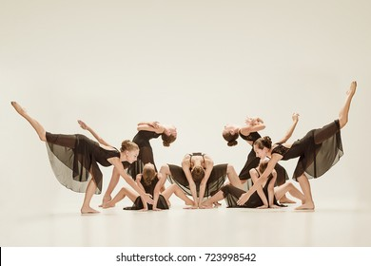
Btec Dance:
Curriculum Leader: Mrs J Capers

Slide 2
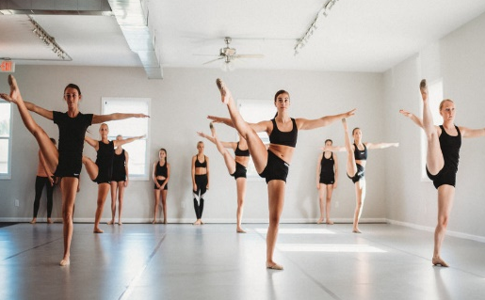
GCSE course overview
BTEC Performing Arts – Dance is an exciting course, that gives students the opportunity to learn new dance skills, dance styles and choreographic devices which will equip them with the skills they need to be successful on the course and beyond.
All 3 component of the course has a practical and theory element. Students will analyse dance works and discover how choreographers create their work; this culminates in practical dance assessments and a presentation of the research they have completed.

Slide 3
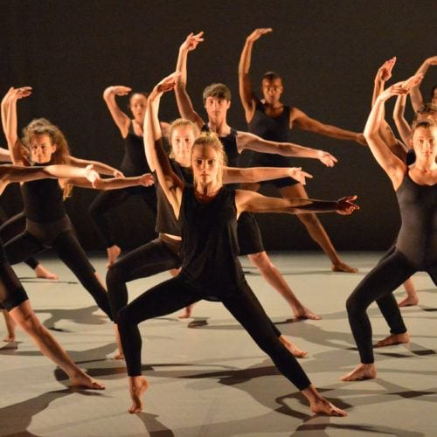
Year 9
Students will experience technique classes in a number of different dance styles, understanding how to recognise a dance styles and perform in that style.
There is the opportunity to experience ‘assignment style tasks’, which will give students a thorough understanding of what will be expected of them in the future, whilst increasing their dance knowledge and experiences.
Student’s dance performances will be videoed throughout the course for assessment requirements.
In addition to the dance skills, students will learn important life skills, such as, preparation for auditions/interviews, personal management, decision making, working with others and independent learning.

Slide 4
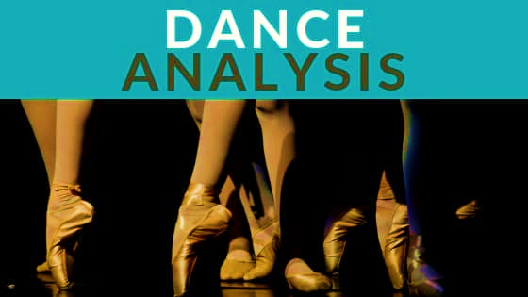
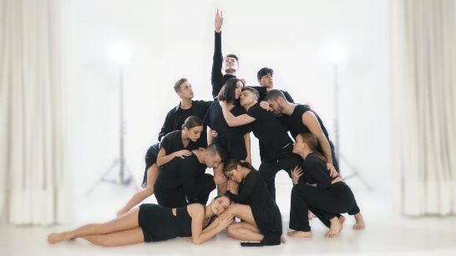
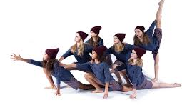
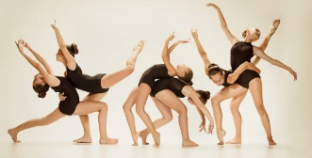
Components studied.
Component 1 – Exploring the Performing Arts Students will develop their understanding of the performing arts by examining practitioners’ work and the processes used to create performance | Component 2 – Developing skills and techniques in the Performing Arts Students will develop their performing arts skills and techniques through the reproduction of dance repertoire.
Component 3 – Performing to a Brief – External Assessment Students will be given the opportunity to work as part of a group to create a workshop performance in response to a given brief and stimulus.

Slide 5
How are the students assessed?
Students will be assessed on the four main aspects of the BTEC course:
Physical skills
Interpretive Skills
Personal Management
The ability to review their own practice.
In addition, students will focus on three different dance works, researching how the chosen choreographers create their work and the practitioners involved in the process.
Internally assessed components – Students are graded on their ability to work in a team situation, taking responsibility for specific areas of performance. The final performance is videoed for assessment and key rehearsals will also be recorded to help evidence their performance. Students will produce a presentation evidencing their research.

Slide 6
Future career pathways/Post 16 choices
Training Pathways | Career Routes
A2 Dance courses BTEC National in Performing Arts: Dance, Drama, Performing Arts Community Dance Leader Award Degrees—BA/MA –various courses including Dance Choreography. PGCE in Dance teaching Diplomas in various genres | Critic/Journalist Movement Therapist Photographer Set/Costume Designer Administration Dancer—Film/TV/Company Owning a Dance School Project Management in the Performing Arts industry Professional Dancer Teaching Freelance/Education

