Slide 1
Subject: Modern Foreign Languages
Head of Department:
Ms Laura Fusano

Slide 2
GCSE course overview
Foundation or Higher
Paper 1: Listening (25% of the overall course)
1 exam in the IT room
Paper 2: Speaking (25% of the overall course)
3 mini exams – one role-play; one photo-card description & 1 open conversation
Paper 3: Reading (25% of the overall course)
1 exam in the hall with a number of questions & 1 translation into English
Paper 4: Writing (25% of the overall course)
1 exam in the hall consisting in 2 pieces of creative writing & 1 translation into Spanish/French

Slide 3
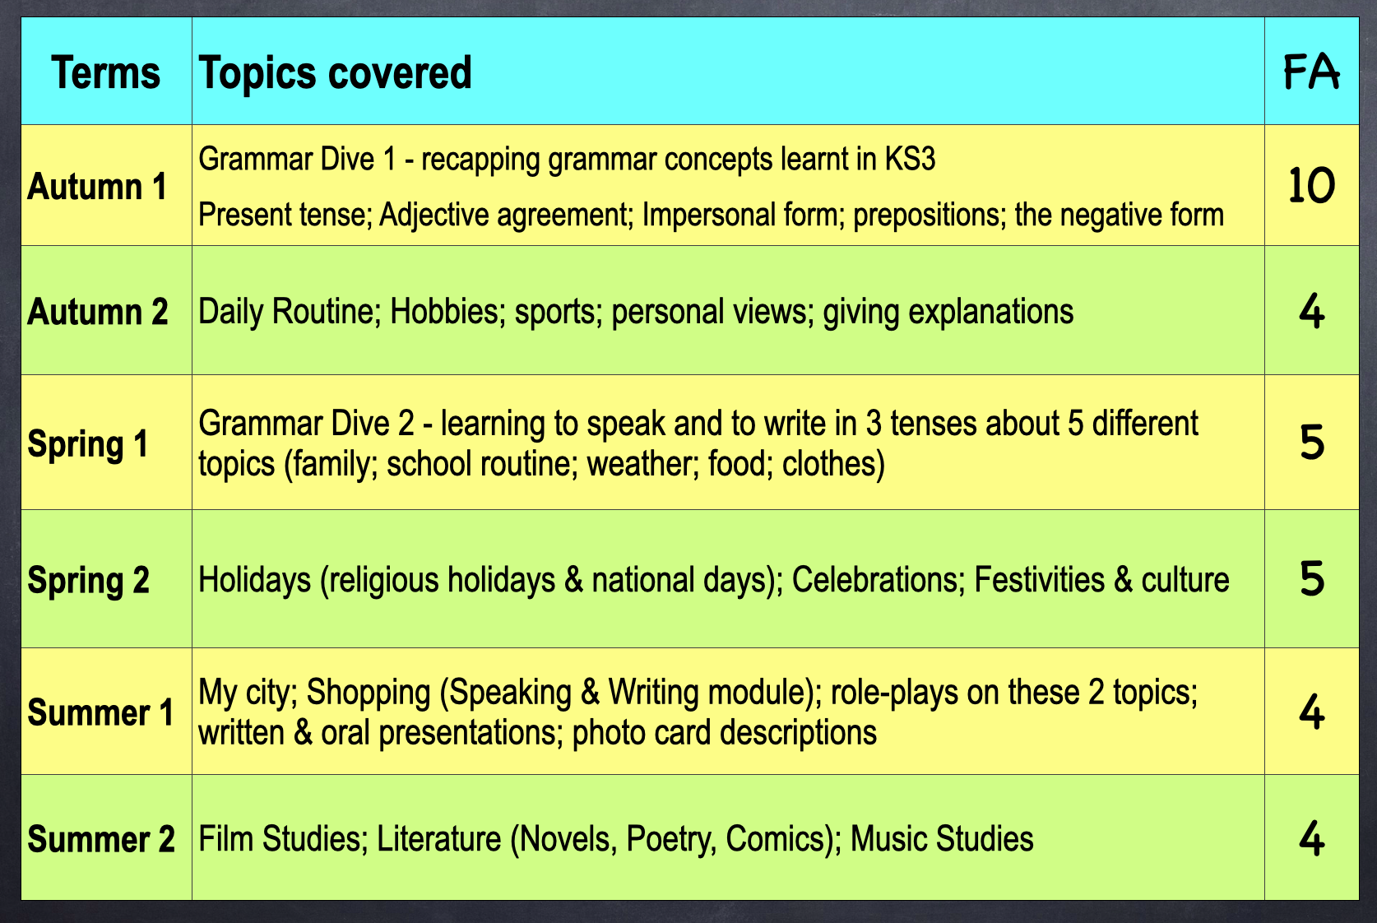
Year 9 Topic Overview

Slide 4
Future career pathways/Post 16 choices
Most people who study languages have strong linguistic skills, love communicating, travelling and are curious about the world outside the UK.
You can study languages at A-level & then at University as part of most degrees.
Language-specific careers: Translator (official documents or literature); Interpreter (legal, sports, music, immigration).
Language-related careers: acting; journalism; photography; media; sports; teaching abroad; travel & hospitality; tourism; international logistics; flight attendant; aviation; import-export commerce; environmental work; etc.
https://www.languagenext.com/blog/career-options-foreign-languages/
https://www.studyfrenchspanish.com/foreign-language-jobs/

