Slide 1
Subject: Mathematics
Head of Department: Mr L Wood

Slide 2
GCSE course overview
2 Tiers
Higher tier = Grades 3-9
Foundation tier = Grades 1-5
3 Exams at the end of Year 11
1 Non-calculator paper.
2 calculator papers.
Each exam 1 hour 30 minutes.

Slide 3
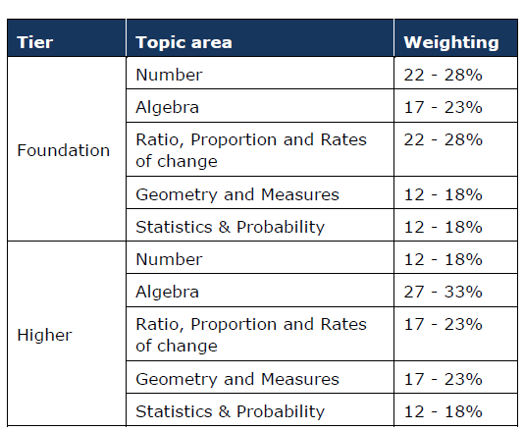
GCSE course overview
2 Tiers
Higher tier = Grades 3-9
Foundation tier = Grades 1-5
3 Exams at the end of Year 11
1 Non-calculator paper.
2 calculator papers.
Each exam 1 hour 30 minutes.

Slide 4
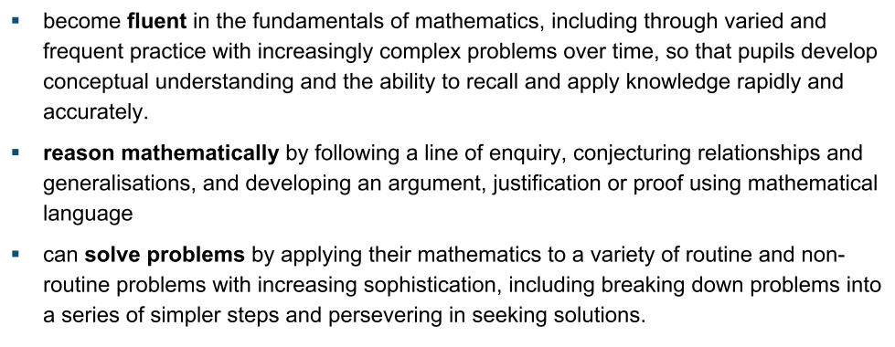
Year 9
We aim for you to:

Slide 5
Future career pathways

Slide 6
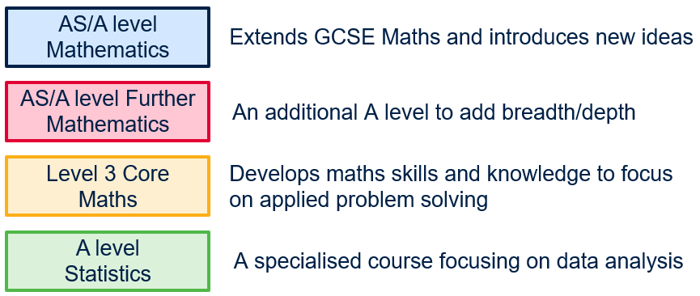
Post 16 choices
You will require a minimum of a grade 4 to progress with further study at college.

