Slide 1


Subject: Music
Head of Department:
Mrs Holden

Slide 2
Year 9
Year 9 Music builds a foundation focusing on developing composing, performing and listening skills in preparation for Years 10 and 11. Year 9 is an opportunity to explore a range of musical styles which will include listening to and analysing music, playing instruments and using music ICT software. You will learn how to compose individually as well as working collaboratively at times and you will have a chance to have your performance recorded in the recording studio if you wish.

Slide 3
GCSE Course overview
Understanding music:
There will be a listening and contextual understanding exam at the end of year 11. This exam is 1 hour and 30 minutes, worth 40% of GCSE marks and marked externally.
Performing music:
Performance 1: Solo performance (15%)
Performance 2: Ensemble performance (15%)
These two combined are worth 30% of GCSE marks. Non-exam assessment will be internally marked by teachers and externally moderated by AQA.
Composing music:
Composition 1: Composition to a brief (15%)
Composition 2: Free composition (15%)
These two combined are worth 30% of GCSE marks. Non-exam assessment will be internally marked by teachers and externally moderated by AQA.

Slide 4
BTEC Course overview
Unit 1-The Music Industry:
There will be a written exam. This exam is 1 hour and is worth 25% of BTEC marks & marked externally.
Unit 2-Compulsory unit:
Managing a Music Product – 25%
Non-exam assessment will be internally marked by teachers & externally moderated.
Optional units:
You will then choose to take 2 other units, these are:
Unit 3 – Introducing Live Sound
Unit 4 – Introducing Music Composition
Unit 5 – Introducing Music Performance
Unit 6 – Introducing Music Recording
Unit 7 – Introducing Music Sequencing
These two combined are worth 50% of total marks (each unit 25% each). Non-exam assessment will be internally marked by teachers & externally moderated.

Slide 5

What will we be studying in Year 9?
Blues

Slide 6

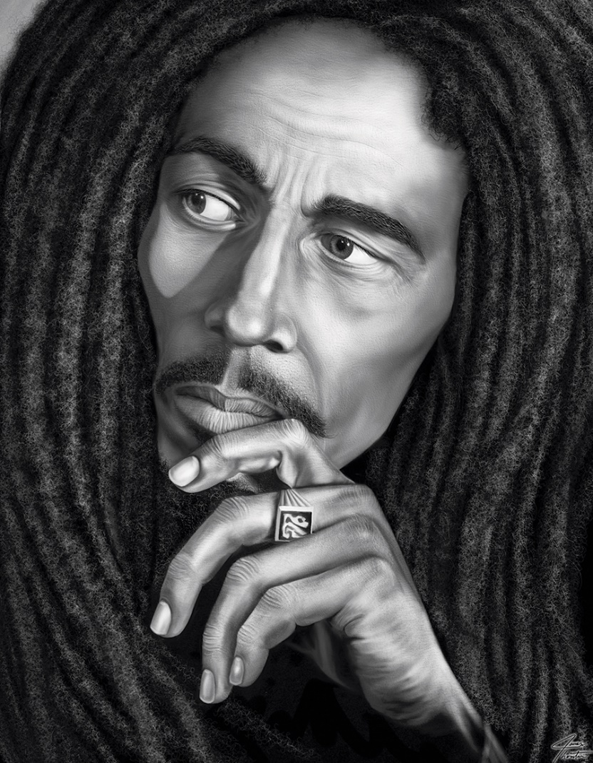

What will we be studying in Year 9?
The Music Industry

Slide 7



What will we be studying in Year 9?
Film Music

Slide 8

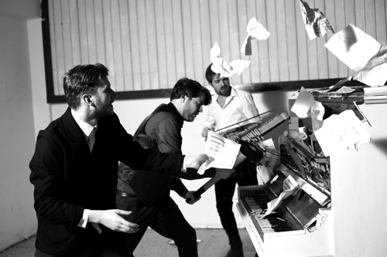
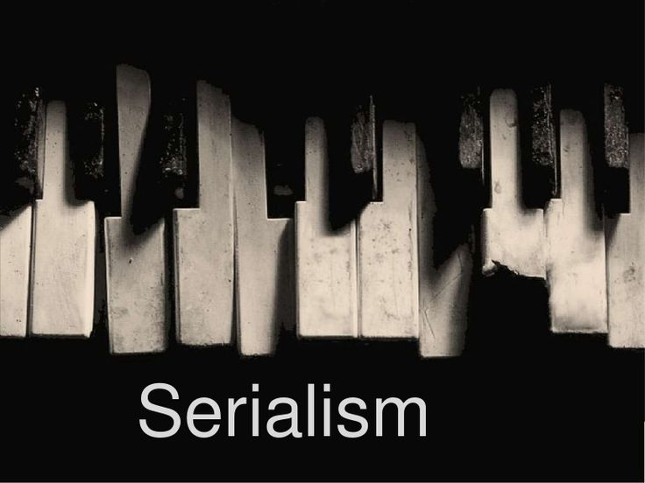
What will we be studying in Year 9?
Western Classical Music (1600-1900 and 1900 onwards)

Slide 9
Future career pathways/Post 16 choices:
Training Pathways | Career Routes
AS & A2 Music AS & A2 Music Technology BTEC Music | Composing Performing Teaching (classroom or instrumental) Music Therapist | Broadcasting Producing Orchestral manager Recording artist Sound engineer

Slide 10
What makes me suitable for the Music?
If you play an instrument or sing well and you like the idea of creating your own music as well as playing that of others, Music is the course for you. Playing an instrument is not essential, however, those that do not play an instrument can only go on to study BTEC Music in Years 10 and 11. You will find the GCSE course more accessible if you have instrumental lessons either within school or privately as the course is very much performance based.

