Slide 1
Subject: RE
Head of Department:
Mr Spencer

Slide 2
GCSE course overview
Paper 1: Religious Themes. (Year 9) | Paper 2: Religious knowledge. (Year 10)
Religion and Life. | Christian Beliefs.
Religion, Crime and Punishment. | Christian Practices.
Religion, Human Rights and Social Justice. | Muslim Beliefs.
Religion, Peace and Conflict. | Muslim Practices.
Religion, Relationships and Family.

Slide 3
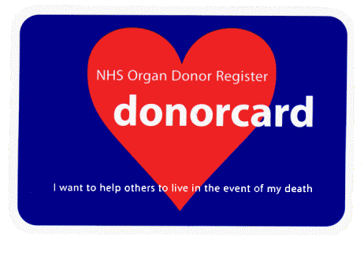
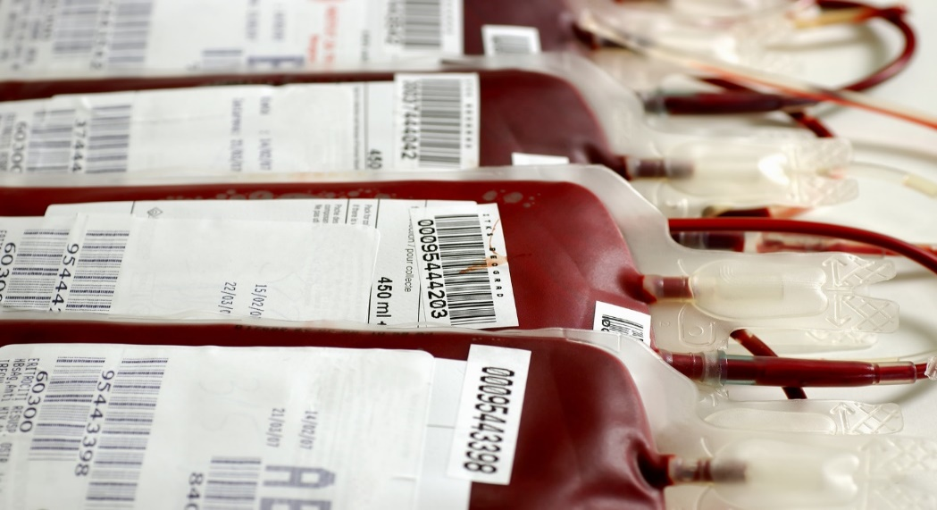
What will we be studying in Year 9?
Religion and Life!

Slide 4
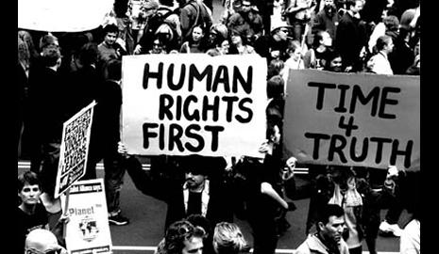
What will we be studying in Year 9?
Religion – Human Rights and Social Justice!

Slide 5
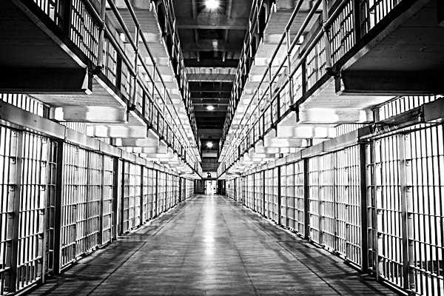
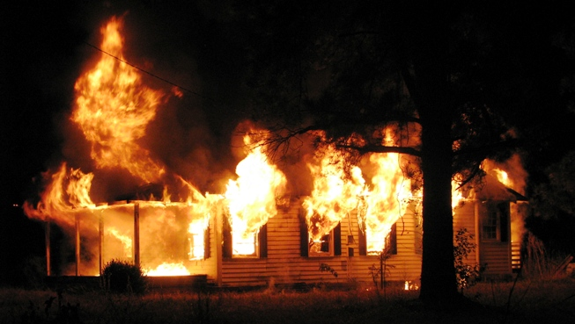
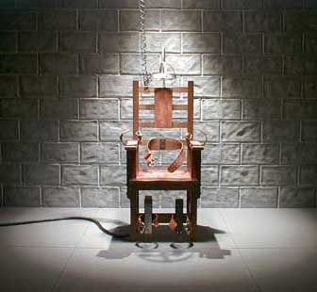
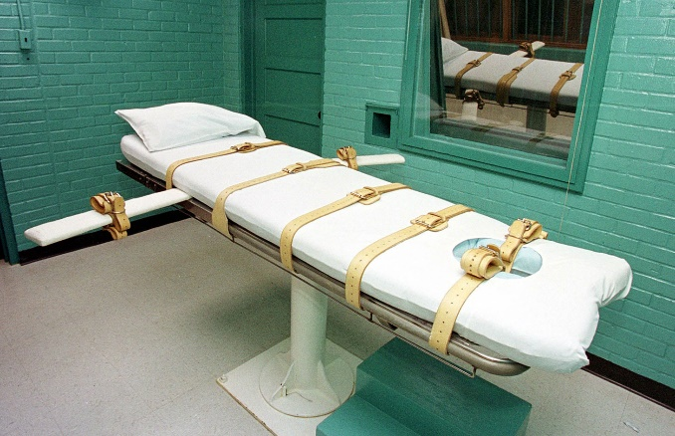
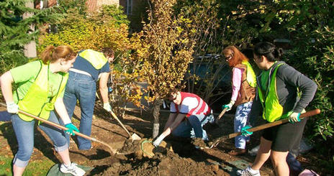
What will we be studying in Year 9?
Religion – Crime and Punishment!

Slide 6
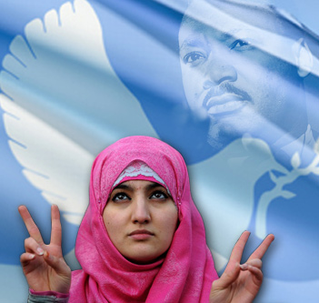
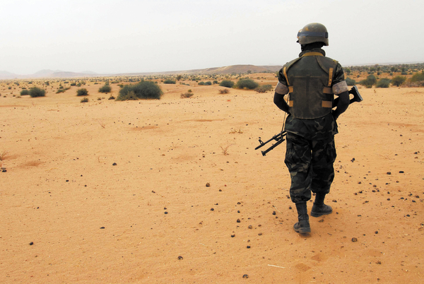
What will we be studying in Year 9?
Religion – Peace and Conflict!

Slide 7
Future career pathways/Post 16 choices:
There are lots of different jobs where your degree would be useful. I have included lots of examples here!
Advice worker
Archivist
Charity fundraiser
Counsellor
International aid worker
Development worker
Mediator
Newspaper journalist
Police officer
Youth worker
Schools, colleges and universities (for teaching and research positions)
Charities and voluntary organizations
Social services and other caring professions.
The church and other religious organizations
Financial and legal firms
The National Health Service (NHS) Doctors / Nurses.
PR, advertising, sales and marketing companies
Media companies.

